Slide 1
A Practical Guide to UTF-8 and Character Encodings
Utah Stack JS meetup
Ken Snyder

Slide 2


Slide 3
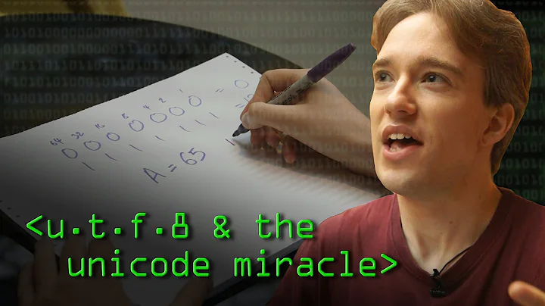
Tom Scott: “The most beautiful hack”

Slide 4
What we’ll cover
History
Design
Landmines
Web technologies
Tools
Emoji

Slide 5
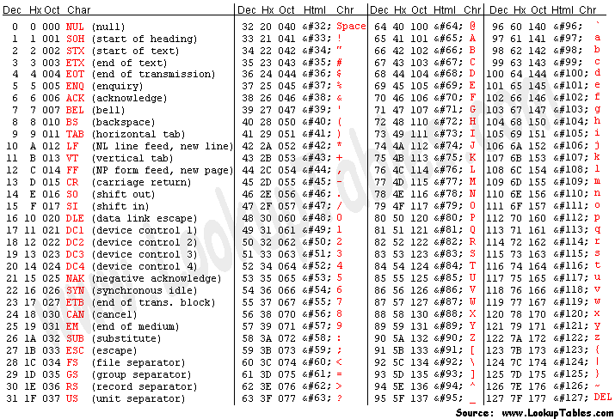
In the Beginning there was ASCII

Slide 6
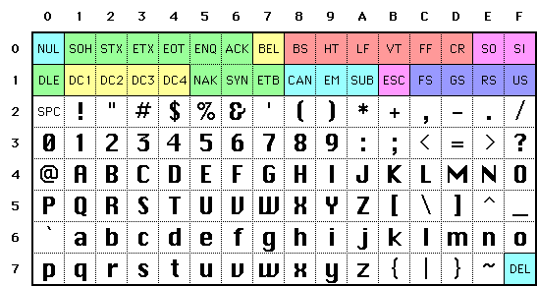

Slide 7
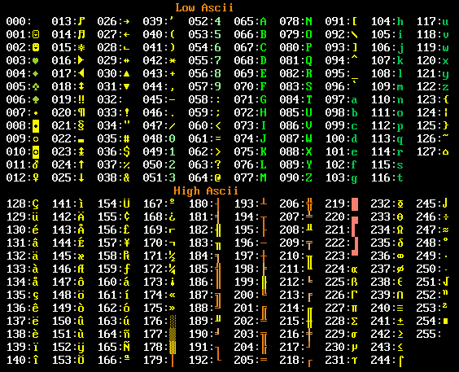

Slide 8
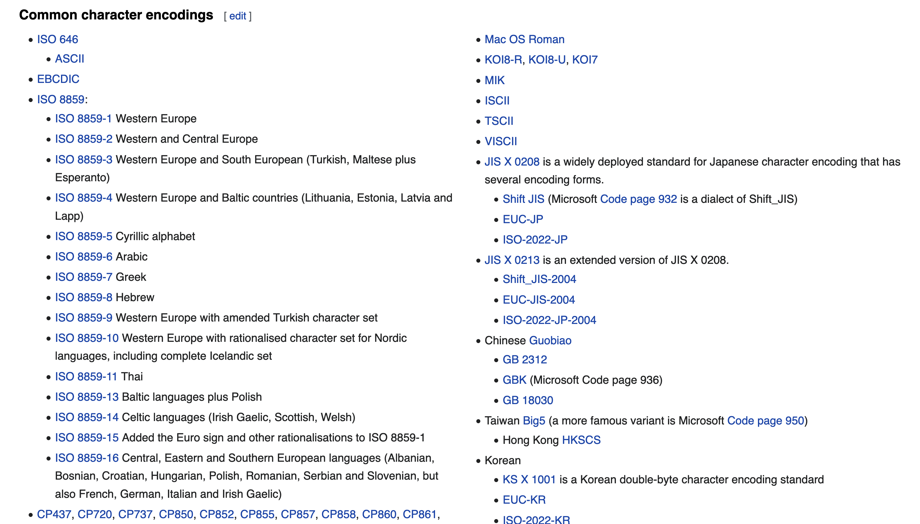
Problem: No interoperability

Slide 9
UTF-8 vs utf-8 vs utf8
UTF-8 is correct
utf-8 is okay in case-insensitive situations
utf8 works in most places
Including Node, HTTP and HTML

Slide 10
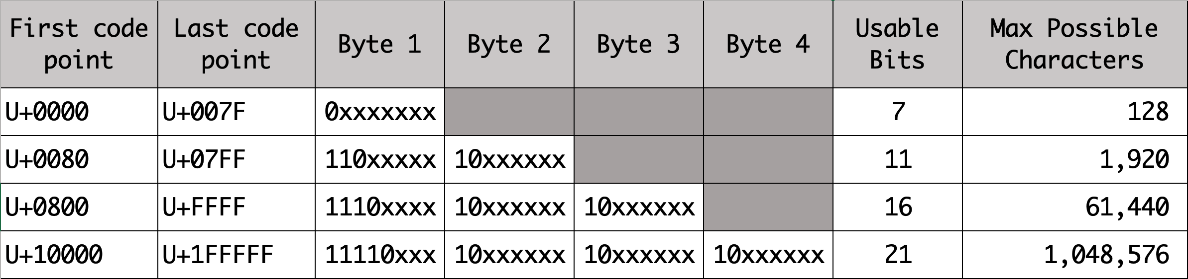
Requirements
English text must be one byte per character
Can’t have 8 zeros in a row (NULL terminator)
Backwards compatible with ASCII
Easily traversable/navigable

Slide 11
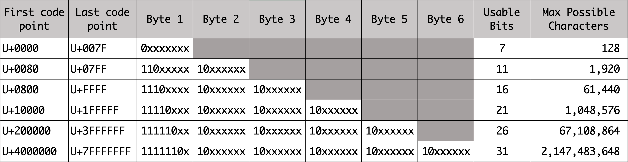
Will theoretically work to 6 bytes

Slide 12
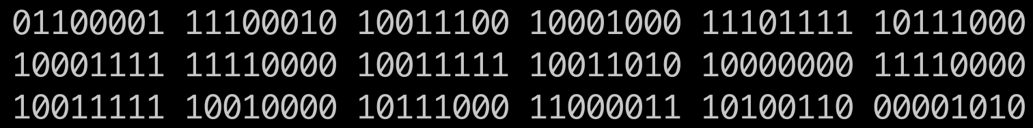
Navigation in a string
Starts with a zero: 1 byte ASCII character = a U+0061 or 97
Starts with 3 ones: 3 bytes = ✈️ U+2708 or 14,851,208
Starts with 4 ones: 4 bytes = 🚀 U+1F680 or 4,036,991,616

Slide 13
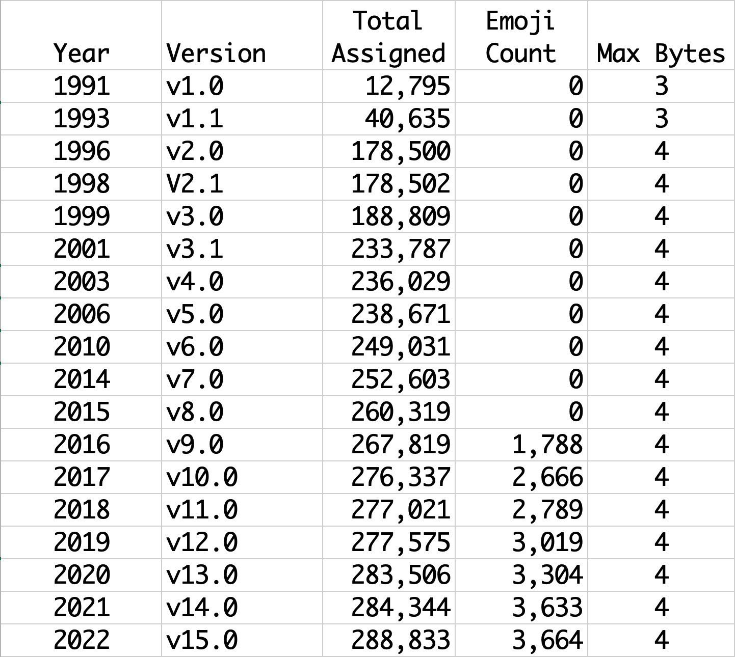
Growth and evolution over time

Slide 14
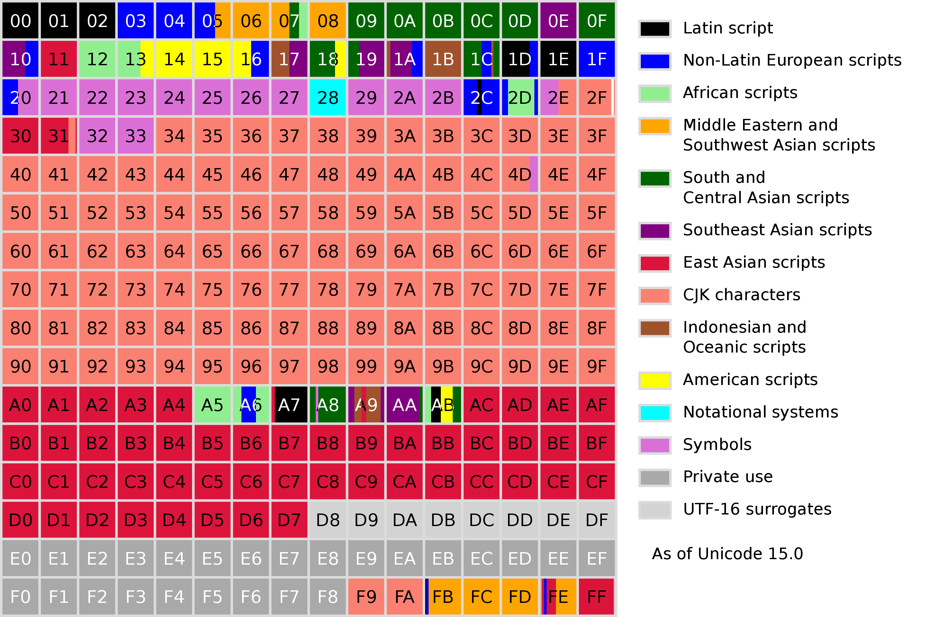

Slide 15
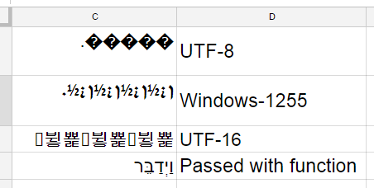
Mojibake

Slide 16
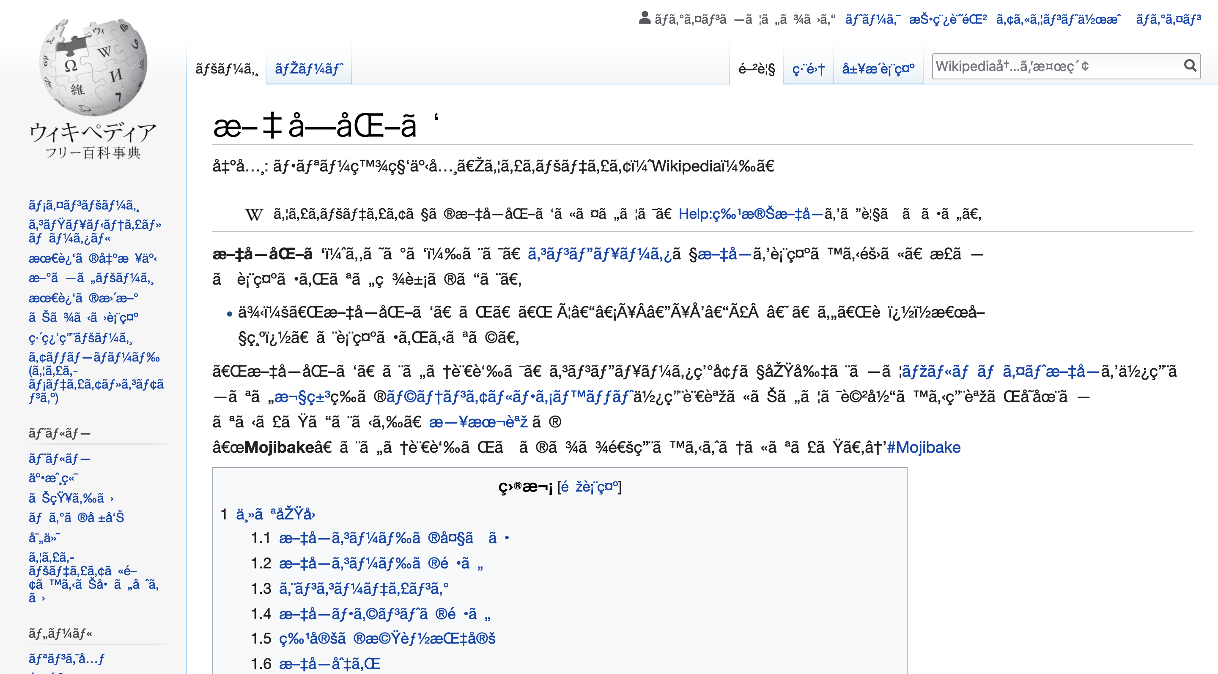

Slide 17
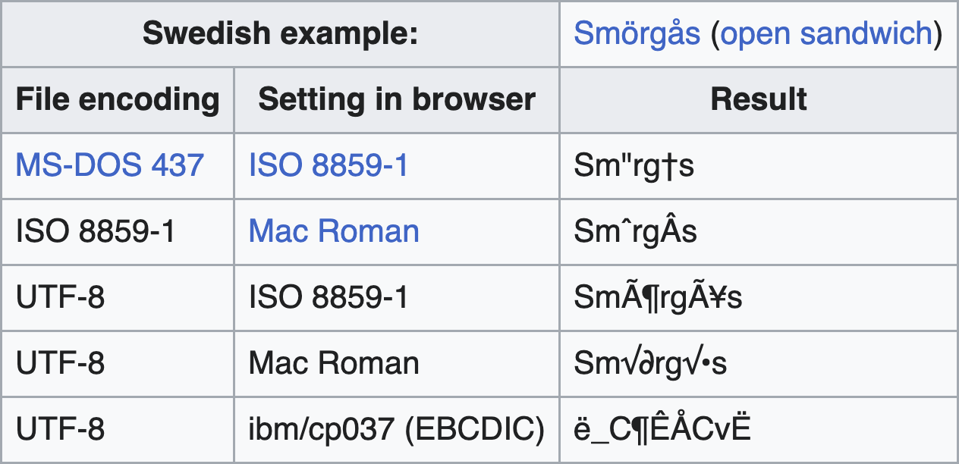
Strange to undecipherable

Slide 18
Character encoding vs character set
UTF-8 is the character encoding
Unicode is the character set
Unicode Consortium curates the character set
UTF-* stands for Unicode Transform Protocol *

Slide 19
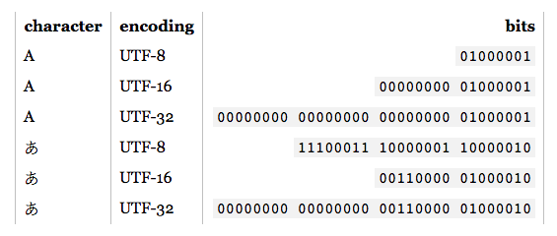
Character encoding vs character set

Slide 20
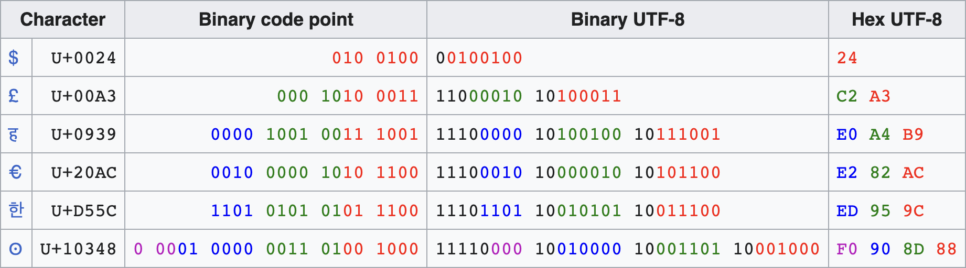
Character encoding vs character set

Slide 21
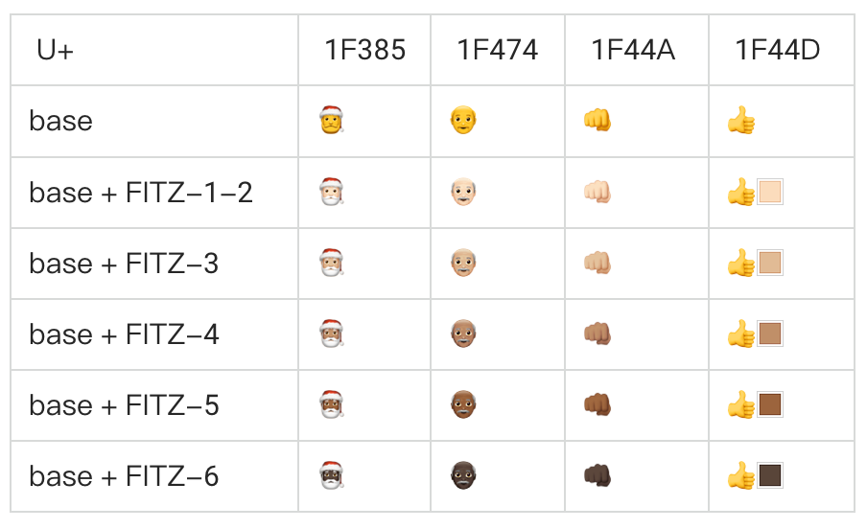
Emoji modifiers

Slide 22
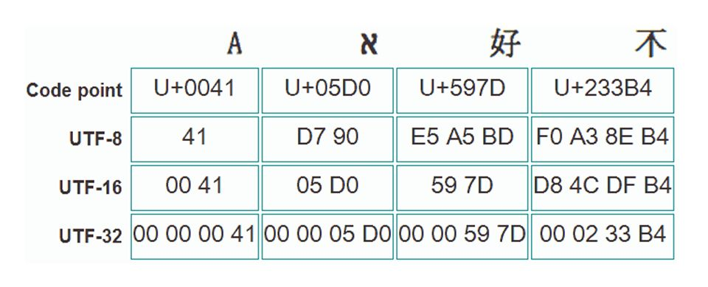
JavaScript strings: an Array of code points

Slide 23
Parts of the stack
Content-Type header to serve document
Browser chooses which encoding to use
JavaScript strings treated correctly
Content-Type from fetch() to server (defaults to document)
Back-end server & language
Connection to database
Database column type

Slide 24
JSON encoding differences - /🚀/\n
Browser - "/🚀/\\n"
Node - "/🚀/\\n"
Go - "/🚀/\\n"
Python - "/\ud83d\ude80/\\n"
PHP - "\/\ud83d\ude80\/\\n” OR "\/🚀\/\\n”
Java, C++ - depends

Slide 25
Databases
MySQL 5.6 & AWS Aurora require specifying “utf8mb4”
Everything else handles UTF-8 by default

Slide 26
String literals: encoding code points
const airplane = “\u2708”;
const airplane = “\u{2708}”;
const airplane = “✈️”;
const rocket = ”\u{1F680}”;

Slide 27
HTML entities code points
Airplane: &#x2708;
Rocket: &#x1F680;
parseInt(”1F680”, 16) => 128640 => &#128640;

Slide 28
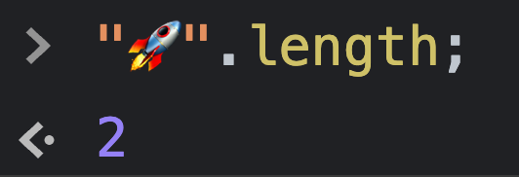
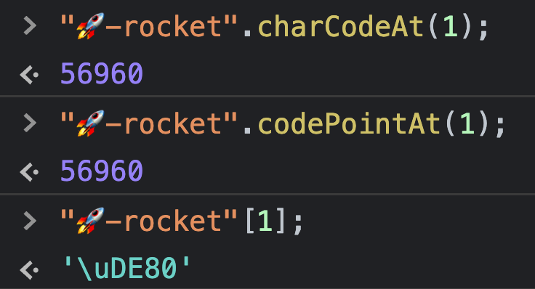
String methods are problematic

Slide 29
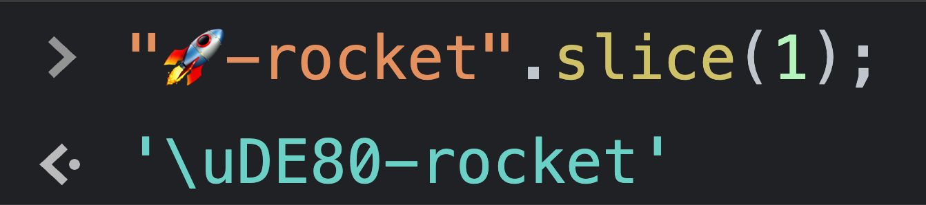
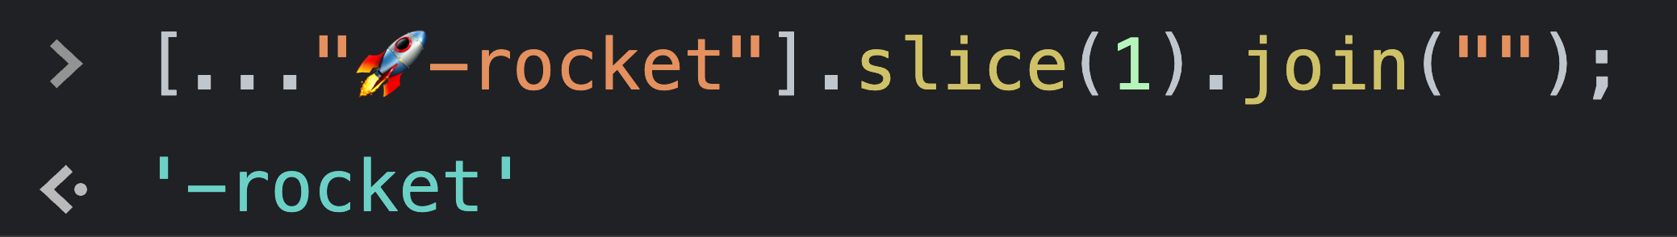
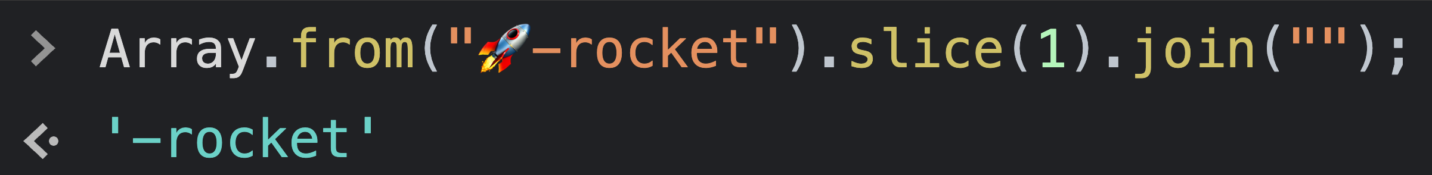
Slicing strings

Slide 30
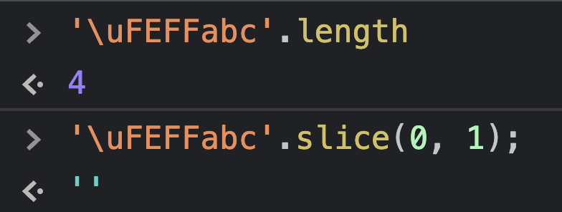
BOM (Byte order mark)
UTF-8/UTF-16 BOM is \uFEFF
It has no meaning and should be ignored
You’ll want to strip it

Slide 31
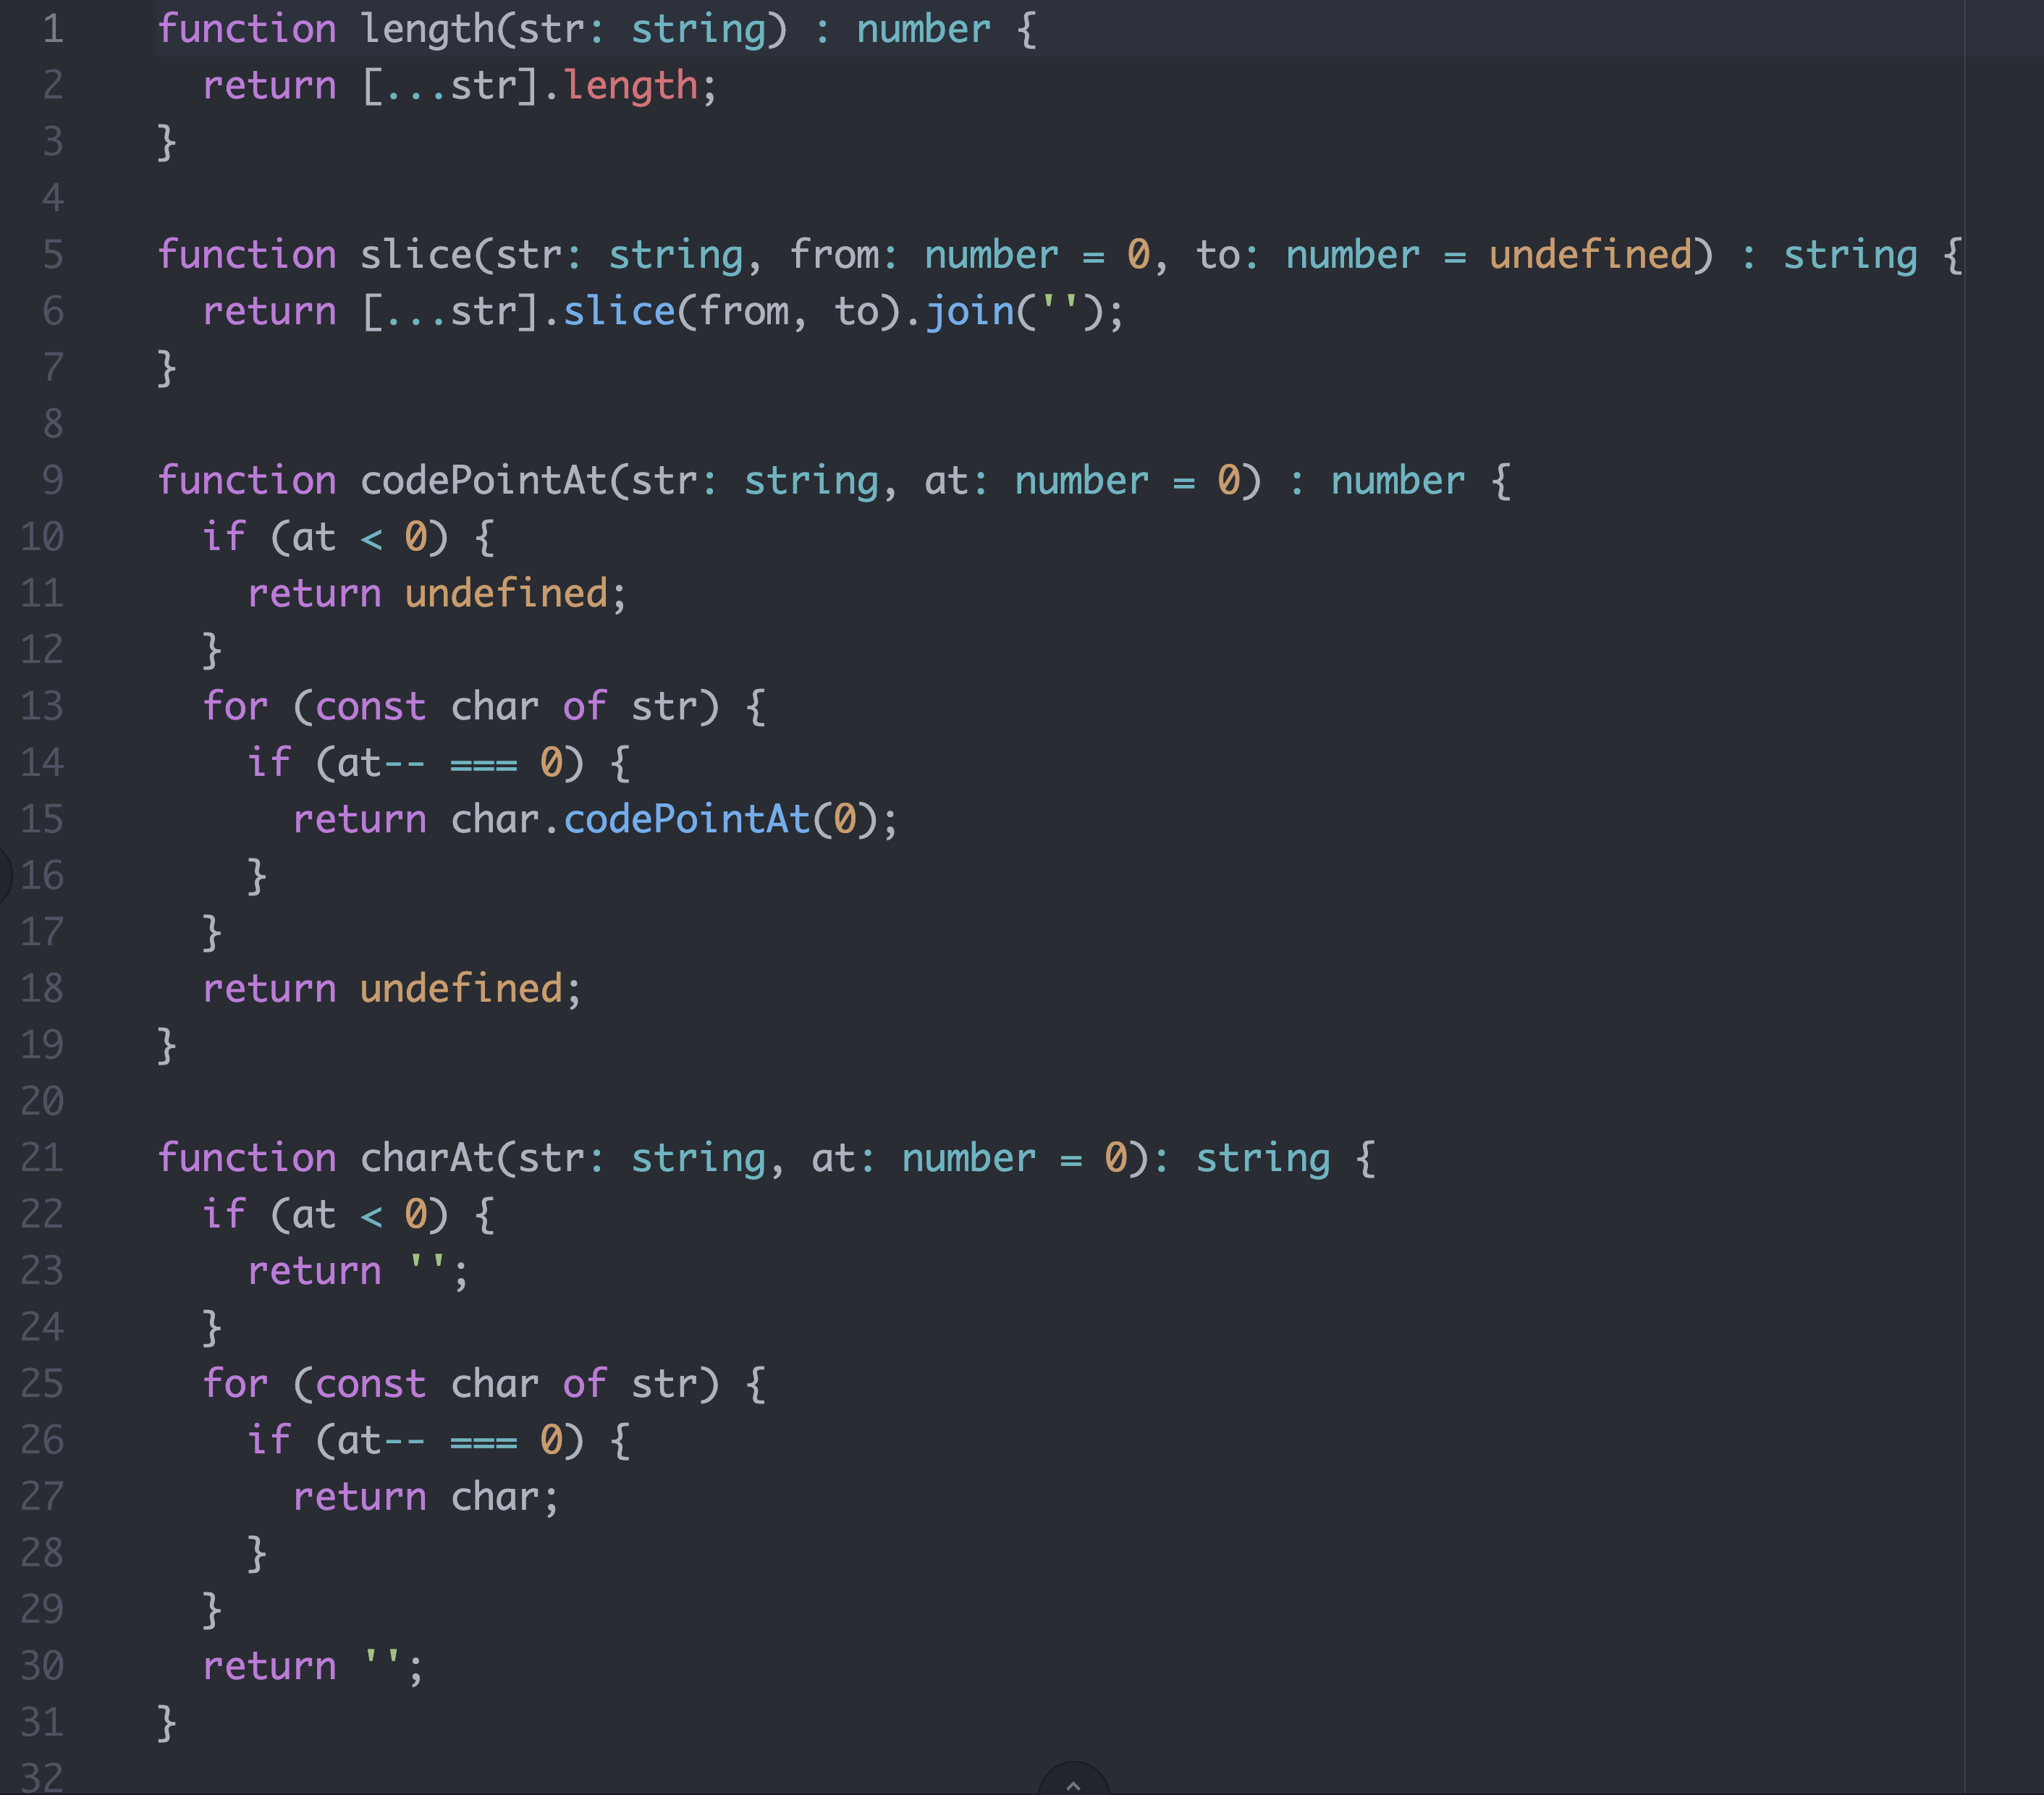
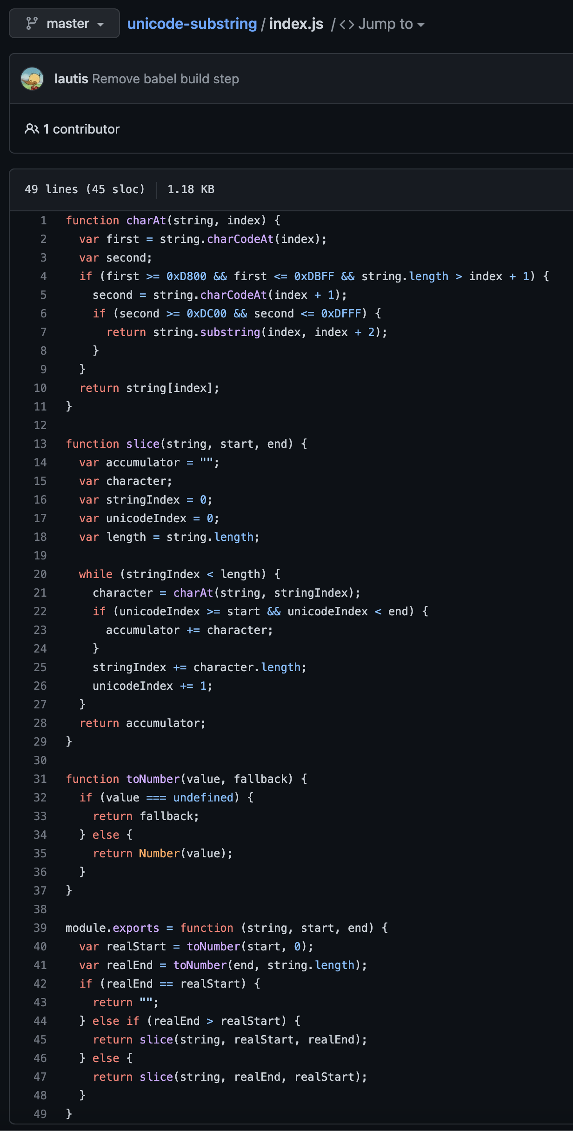
Hello npm?

Slide 32
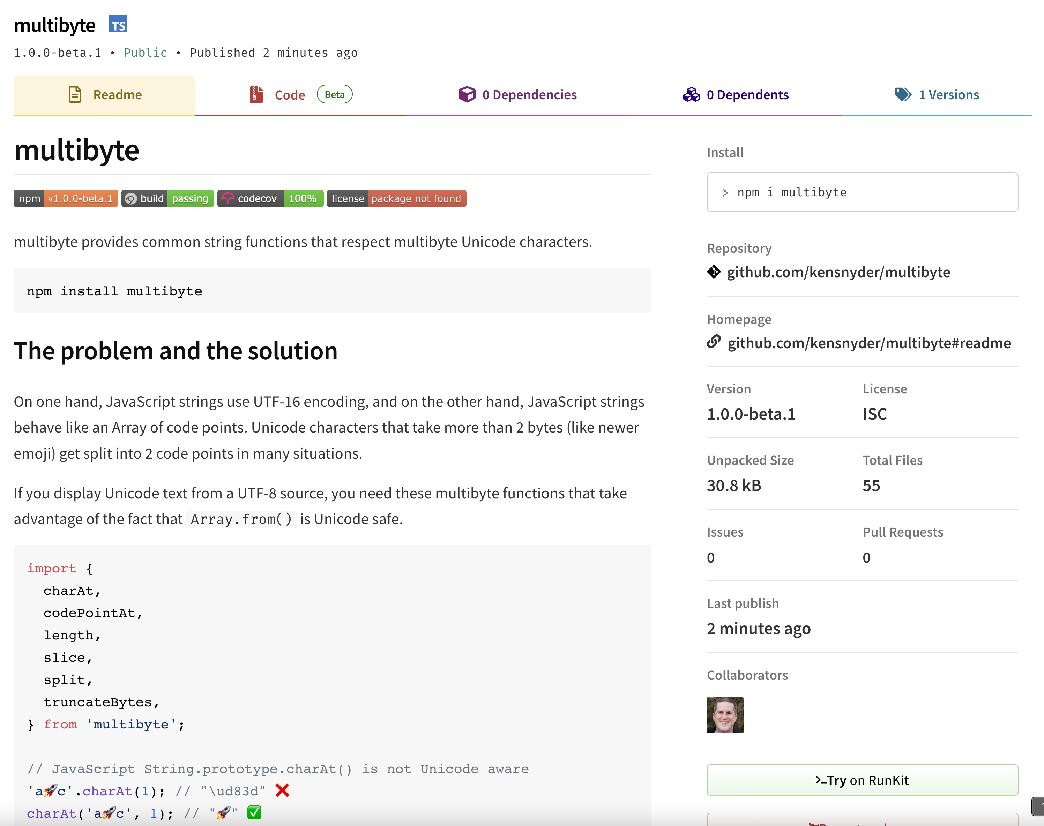
So I did it
https://www.npmjs.com/package/multibyte

Slide 33
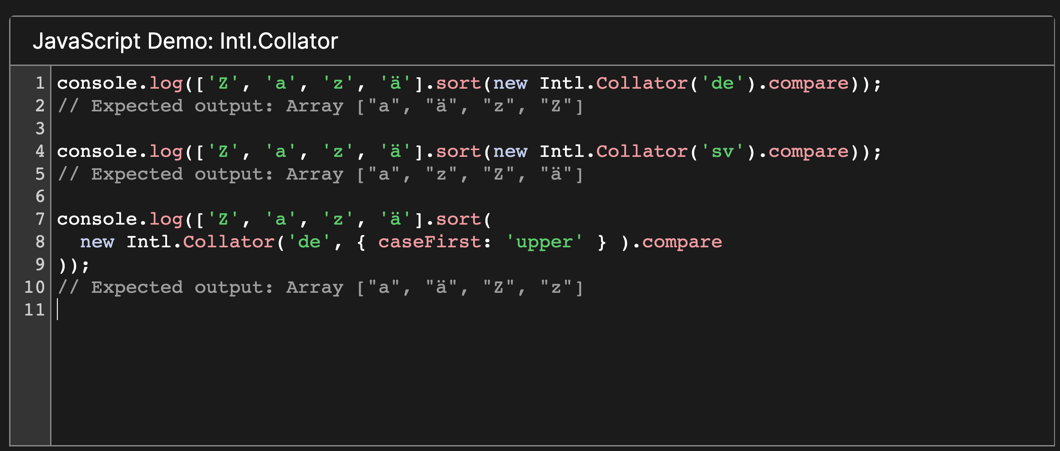
Intl.Collator

Slide 34
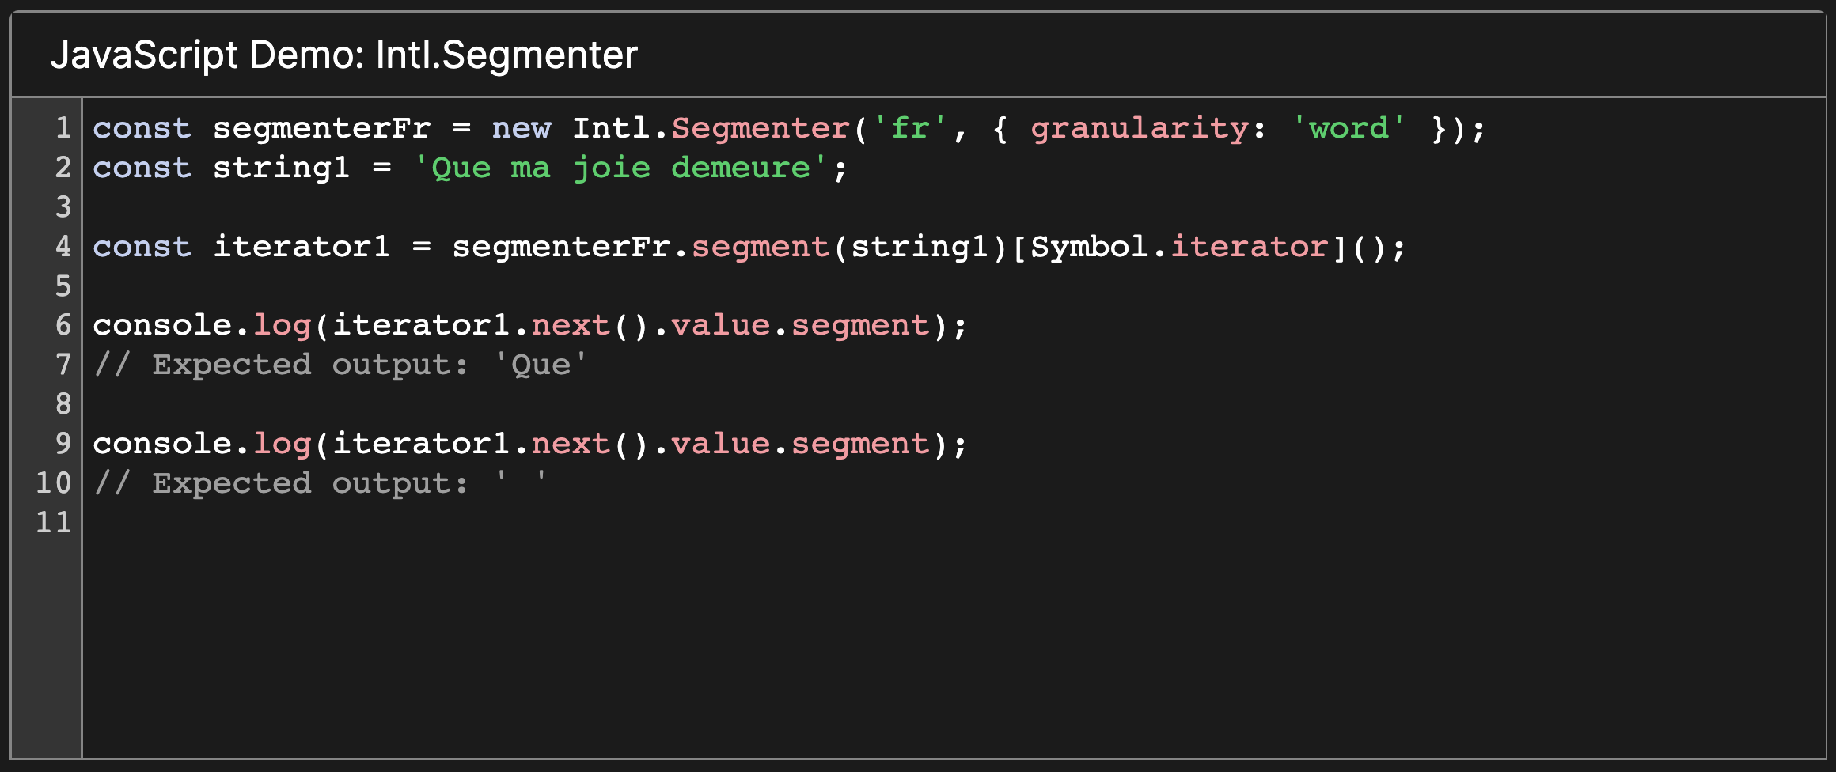
Intl.Segmenter

Slide 35
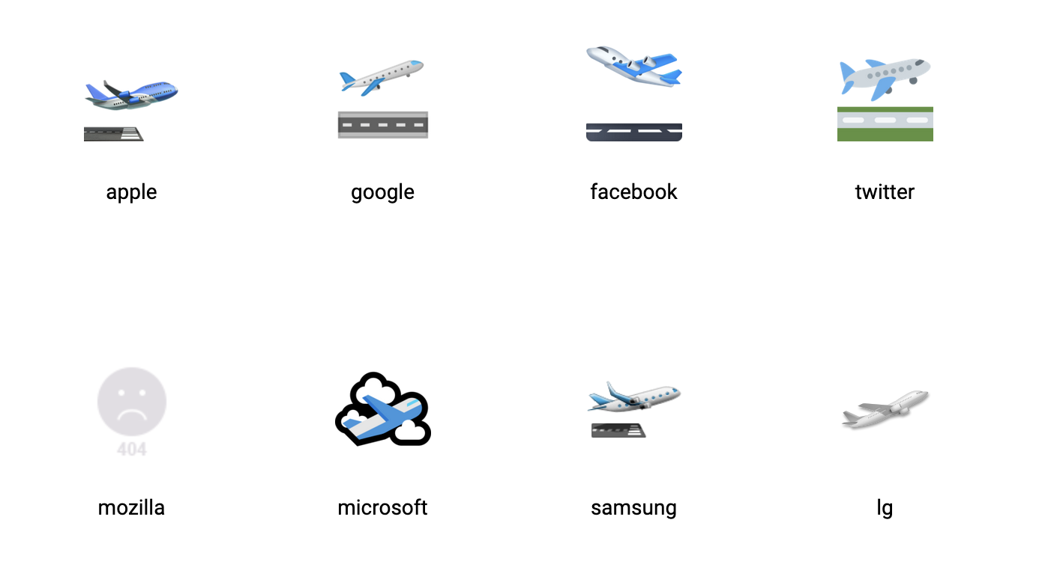
Emoji Implementation

Slide 36
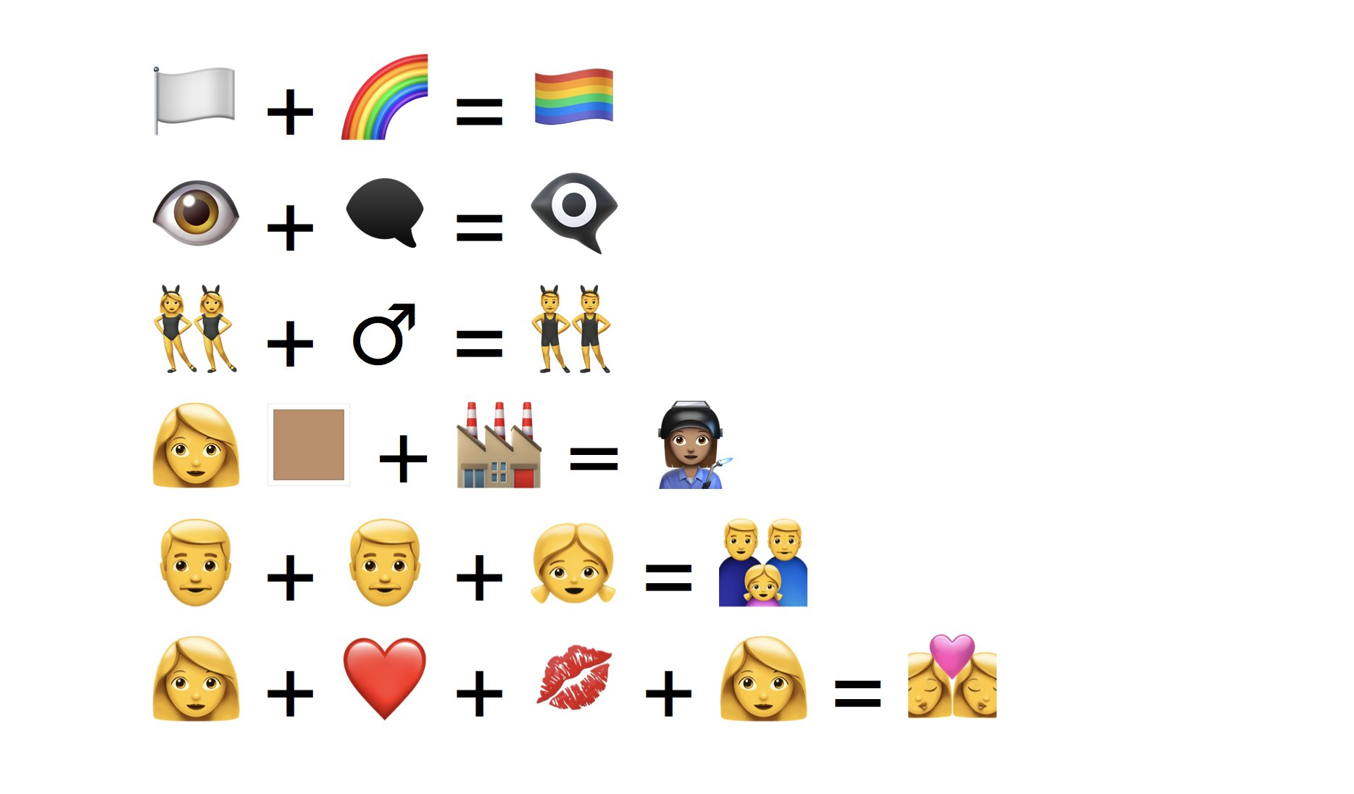
Emoji combinations with ZWJ

Slide 37
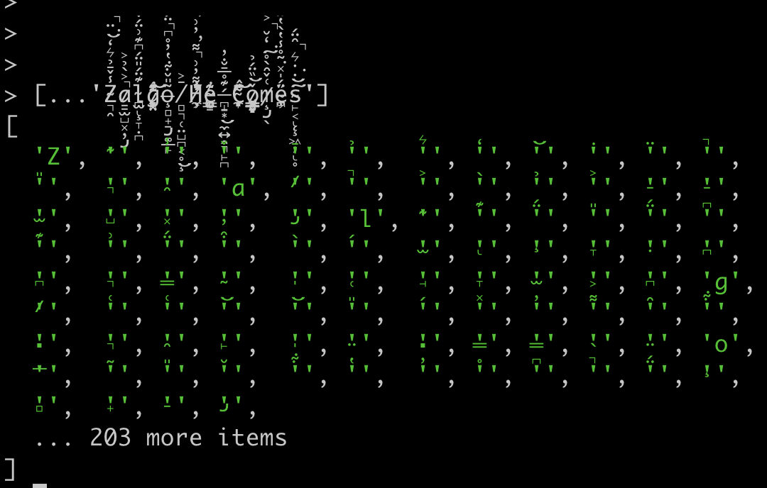
Obligatory Zalgo Text

